Slide 1

Final deliverable – Mis 665
By Zach Logback

Slide 2
Project Description & introduction
The business problem is that a predictive model must be produced to help identify at risk fans. At risk fans are fans that are most likely to defect and not renew season tickets.
Producing a model that can accurately identify at risk fans is extremely important in order to intervene in an attempt to retain those fans.
Using a dataset with 17 variables a scoring model with high accuracy must be produced.

Slide 3

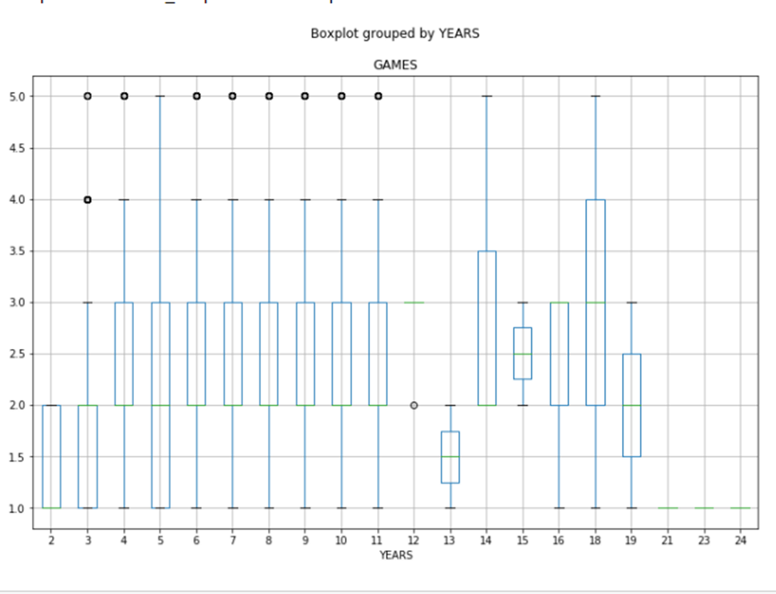
Key findings from data visualization
df.boxplot('GAMES', by='YEARS', figsize=(12, 8))
This boxplot visually shows that generally speaking, the longer that you’ve been a season ticket holder, the more likely you are to attend more games.

Slide 4
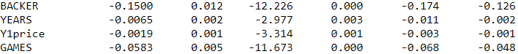
Key findings from Exploratory Data Analysis
These are the results from the regression model I ran with the code below:
runs_reg_model1 = ols('Y2defect~BACKER+YEARS+Y1price+INCOME+AGE+GAMES+PCTMARR',df)
runs_reg1 = runs_reg_model1.fit()
print runs_reg1.summary()
The 5th column represents the P-Value of the variables. Since the P-Value for BACKER, YEARS, Y1price, and GAMES is less than .05, I can conclude that those variables are significant to Y2defect.

Slide 5
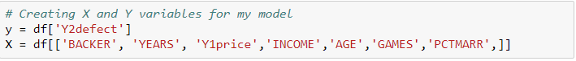
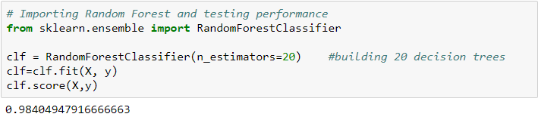
Best classification model – Random Forest
The best classification model I was able to produce was a Random Forest model with the following variables: Y – Y2defect, X – BACKER, YEARS, Y1price, INCOME, AGE, GAMES, PCTMARR.
The decision tree model that I ran resulted in a 56% accuracy and the above model resulted in a 98% accuracy.

Slide 6
Overall Implications and suggestions
Implications:
The season ticket holders most likely to renew are ticket holders that are members of the backers club, have been ticket holders for multiple years, attended multiple games, and ticket holders who pay less money for season tickets.
Loyal fans are most likely to renew season tickets.
Suggestions:
Target ticket holders that aren’t a member of the alumni clubs, pay high prices for their tickets, didn’t attend multiple games, and those who haven’t had season tickets for multiple years.
Some other variables that could improve the model prediction include the ticket holders permanent address or where they are located, and possibly if they attended games while being a student.

